Slide 1
Objects

Slide 2
Objects in Python
Everything in Python is an object.
7 and “text” are examples of Python objects.
An object is a container for data.
When you type in 7, Python creates an object to store the data in.
Why is this important?
At a low level, all data is stored as a bunch of zeros and ones in memory.
The data for 7 has to be kept separate from the data for “text.”

Slide 3
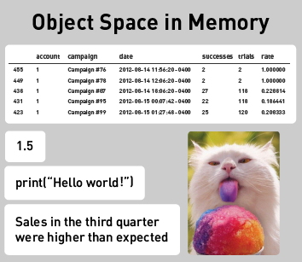
Objects
Objects keep things separate.
Objects are similar to containers that can hold any type of data.
Even code is held in objects.

Slide 4
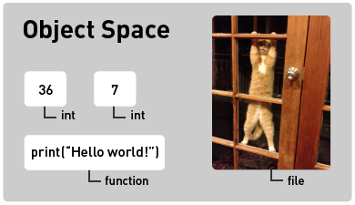
Types
Notes:
Each object in Python has a type.
Type or class are interchangeable in Python 3.
In this object space, you can see that 36 is of type int, so we know it holds an integer.
The print line is of type function, so we know that it's something we can run.
In computer memory, all objects are stored as zeros and ones, indistinguishable to humans.
You wouldn't be able to look at the zeros and ones and tell a table of customer data apart from a photo.
But of course, the types of things you can do to a data table are very different than those you can do to a photo.
For this reason, we need to keep track of what type of data is in each object.

Slide 5
Strongly Typed Languages
Python is strongly typed.
Python will restrict the operations you can perform, based on an object’s type.
This keeps you from making some mistakes.
In a weakly typed language, there are fewer rules.
The language will let you do things like add functions together, but the result probably won’t make any sense.
Notes:
Python is strongly typed.
Python will restrict the operations you can perform, based on an object’s type.
This keeps you from making some mistakes.
In Python - For example, you can add two integers together, but not two functions.
In a weakly typed language, there are fewer rules.
The language will let you do things like add functions together, but the result probably won’t make any sense.

Slide 6
Objects

